Slide 1
Media Recommendation
Robert Gingras, Henry Green, Rowan Akers, Benny Bergle

Slide 2
Search & Filter
The search screen will be the first page a user sees.
Simple layout with a logo & search bar.
React components
Query MongoDB database with user input using NodeJS
The filter screen will be the second page a user sees.
Display requested results and filters
Filters will allow the removal of media containing certain tropes from results
Search…
Search…
Filters…
Results…

Slide 3
Recommendation & External APIs
The recommendation page will be where you can find related media based on your input
The use of multiple APIs will help get correct images, titles and descriptions for TV shows, Movies and video games
It will show the media you searched for with related media underneath like amazon’s “People who buy this also buy”
Image
Details
Related

Slide 4
MongoDB & Normalization
Using the MongoDB Node driver to work with Node.js
MongoDB Atlas
Database migration
Cloud control
SQLitemongo tool
Open-source tool helps convert SQLite files to MongoDB
Avoids duplicate uploads and converts with a small number of commands
Data normalization
Streamline searching
Reduce size of database
Reduce redundancy
Increase integrity

Slide 5
Server API
Provides JSON response to GET queries about specific searches and media
“/search” endpoint
“?title=” returns results of media which case-insensitive wildcard match the provided string
“?filters=” comma separated list of trope filters, which queries for the intersection of media associated with those tropes
“/recommendation” endpoint
“?id=” the unique key for the media record the user is querying

Slide 6
Optional Requirements
Continuous web crawling
Metadata about piece of media
User accounts
Paging system for server endpoints

Slide 7
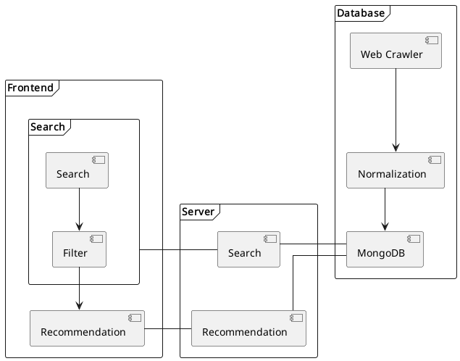
The Diagram

